Slide 1


National Education Society ®
JNN College of Engineering
Sawalanga Road, Navule, Shivamogga -277204
(Accredited by NBA, NAAC 'B' & Certified by UGC 2f & 12B)
Department of Electronics & Telecommunication Engineering
PROJECT FINAL PHASE SEMINAR
“SMART AIRBAG SYSTEM FOR FALL PROTECTION”
Presented by:
Under the guidance of:
Dr. Ushadevi M B Professor, Dept. of ETE JNNCE, Shivamogga
BHUMIKA S G 4JN19ET010 IMPANA B 4JN19ET015 MADHU G D 4JN19ET017 MEGHANA G P 4JN19ET021

Slide 2
CONTENTS:
Aim of the Project
Introduction
Block Diagram
Objectives
Circuit Diagram
Hardware implementation
Software implementation
Results and Discussion
Conclusion
Future Scope
Advantages
Applications
References

Slide 3
AIM OF THE PROJECT
Here we are presenting the smart air bag system to protect a person from injury in the event of a fall.
This system must be able to detect a fall accurately and quickly, and then deploy the air bag to person's impact with the ground.

Slide 4
INTRODUCTION
Older people frequently fall. This is a serious public health problem, with a substantial impact on health and healthcare costs.
Considering elder individual’s hip fractures account for most of the deaths and costs of all fall-induced fractures.
Here we are implementing a “Human Airbag System for Fall Protection”, which inflates suddenly when an accidental fall is about to happen.
The main aim of the human airbag system is to reduce impact force on hips.

Slide 5
Worldwide, there are around 40,00,000 hip fracture cases every year, and the annual mortality rate is 30.8%.
In India, every year, nearly 1.5–2 million older people suffer injuries due to falls, and 1 million people to death is happening due to falls.

Slide 6
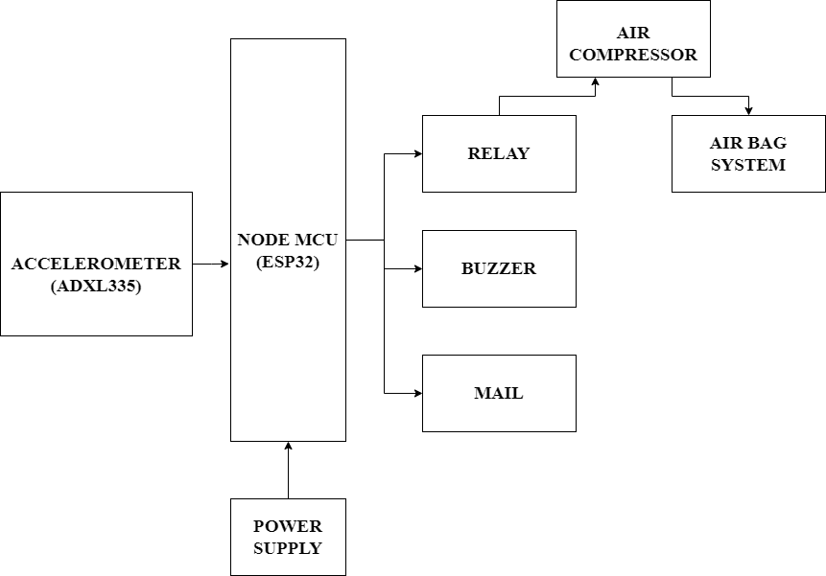
BLOCK DIAGRAM
6

Slide 7
OBJECTIVES
To design and create a Fall Detection System for the elderly that will protect them from hip and back injuries,the system has to be wearable and capable of detecting a fall before the impact. The device has to be able to detect dangerous tilt and if a fall has occurred, must inflate the airbag within a few milliseconds.
In the event of a fall or a dangerous tilt, the device has to be able to be very sensitive to the motion and differentiate between ADL’s.
Throughout the process, the algorithm must continuously collect data and implement the threshold algorithm when needed.

Slide 8
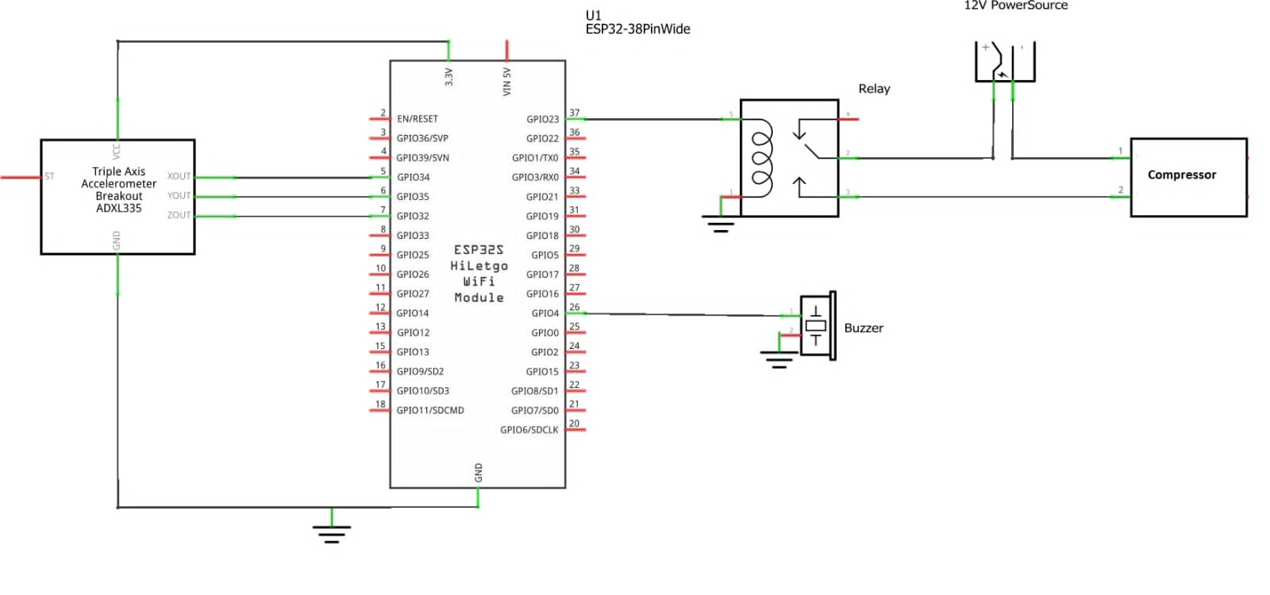
CIRCUIT DIAGRAM
Dept
8

Slide 9
HARDWARE REQUIREMENTS
Node MCU ( Esp32 )
Accelerometer ( Adxl335 )
Relay
Compressor
Buzzer
Adapter
Air bag system

Slide 10
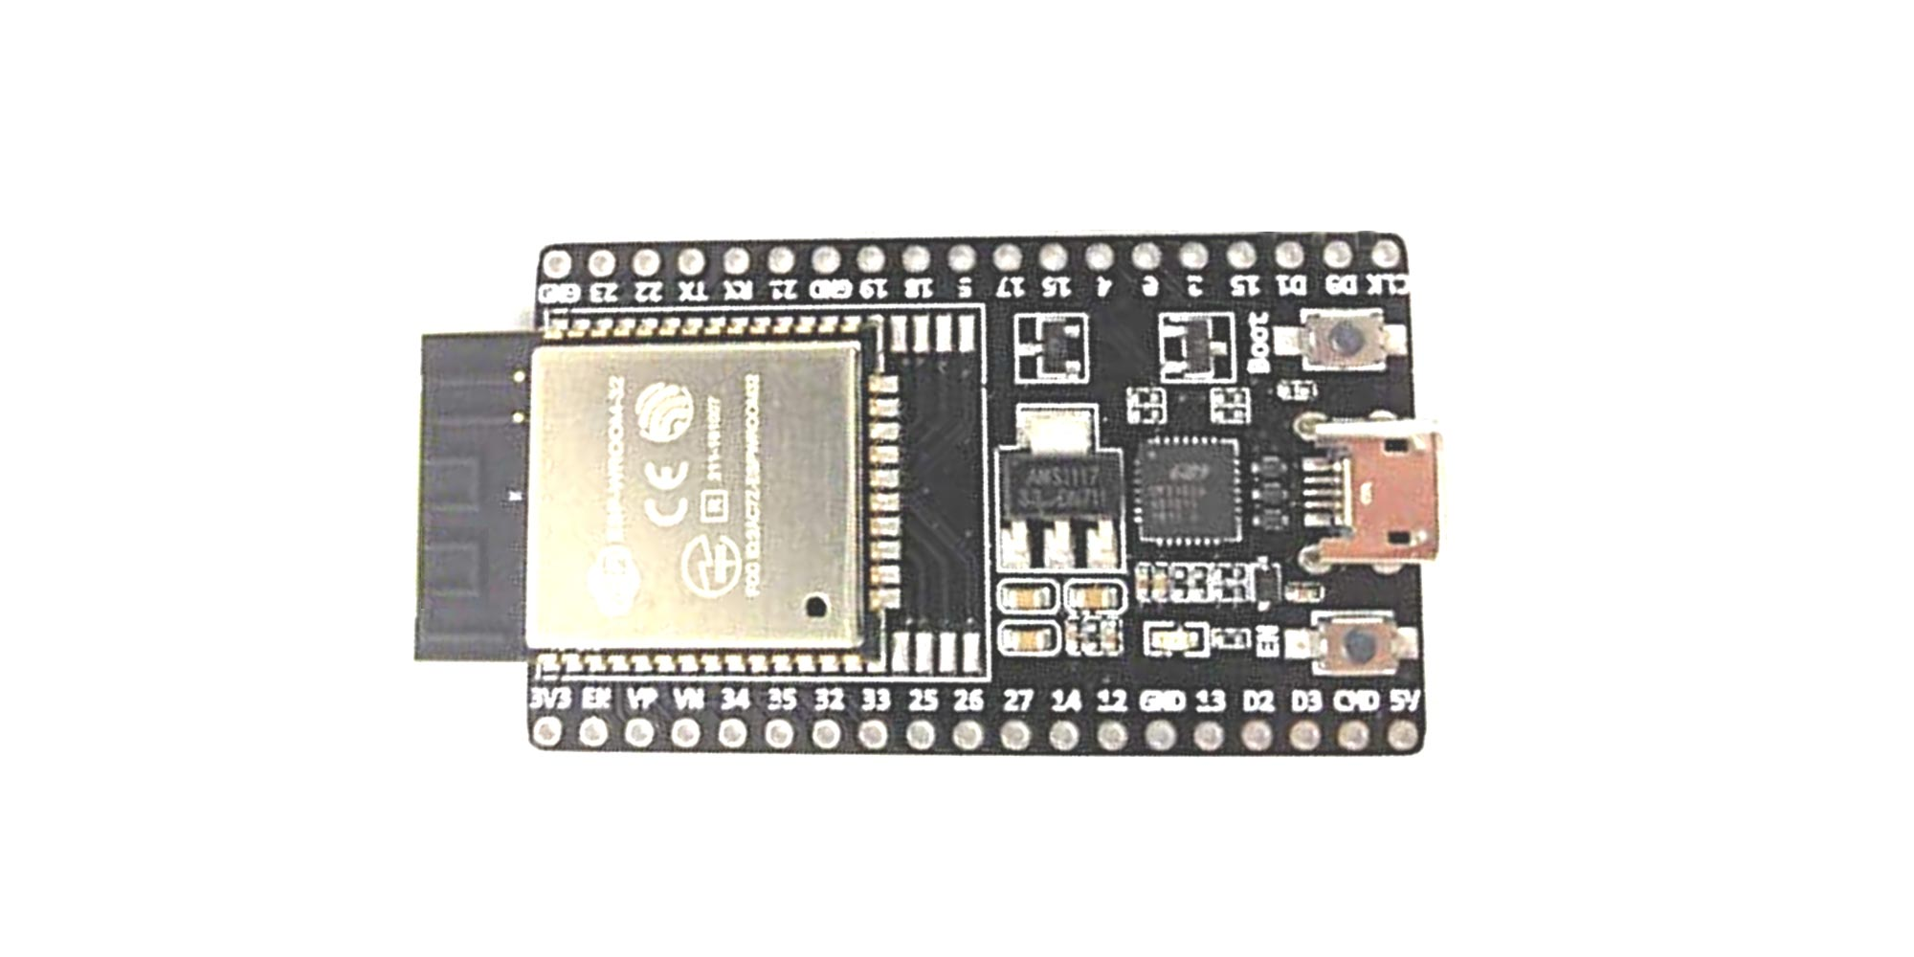
1. NODE MCU ( ESP 32 )
Figure: NODE MCU ESP32

Slide 11
Specifications
The specifications of the ESP 32 include the following
520 KB of SRAM, 448 KB of ROM and 16 KB of RTC SRAM.
Support for both Classic Bluetooth v4.2 and BLE specifications.
34 Programmable GPIOs.
Up to 18 channels of 12-bit SAR ADC and 2 channels of 8-bit DAC

Slide 12
It is designed used in IoT applications and can be used to connect to a variety of sensors and other devices.
In an airbag system for fall protection, the ESP32 can be used to monitor the status of the system and trigger the deployment of an airbag in the event of a fall.
The ESP32 is connected to various sensors, such as an accelerometer that can detect the movement and orientation of the person wearing the system.
The ESP32 continuously monitors the sensor data and compares it to a set of pre-defined thresholds.

Slide 13
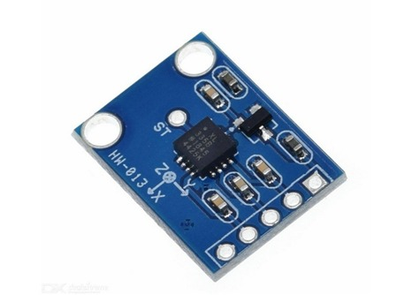
2. ACCELEROMETER ( ADXL335 )
Specifications
The specifications of the accelerometer include
the following:
Operating Voltage: 3V to 6V DC
Operating Current: 350μA
High Sensitivity for small movements
Figure: ACCELEROMETER ADXL335

Slide 14
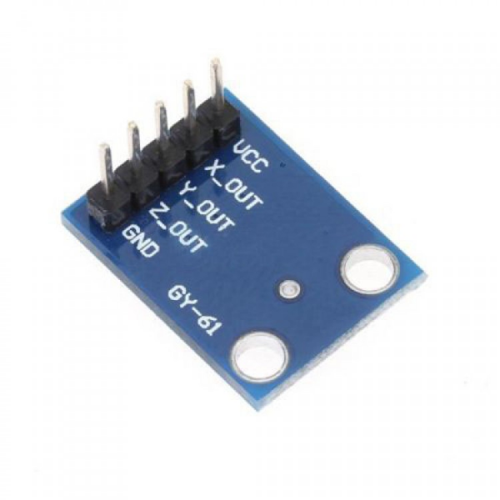
The ADXL335 is a small, low power, complete 3-axis accelerometer with signal conditioned voltage outputs.
It can measure the static acceleration of gravity in tilt-sensing applications, as well as dynamic acceleration resulting from motion, shock, or vibration.
Figure: ACCELEROMETER ADXL335

Slide 15
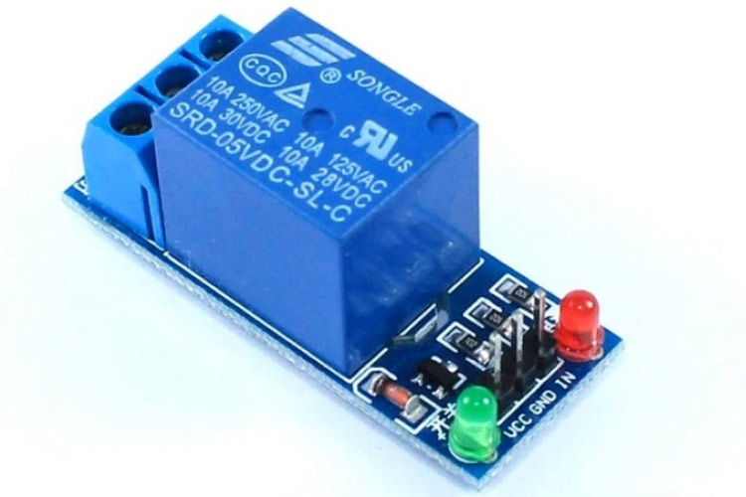
3. Relay
Specifications
The specifications of the relay include the following
Supply voltage – 3.75V to 6V
Quiescent current: 2mA
Figure: Relay

Slide 16
Relays are used in many different systems to control the flow of electricity.
In the context of an airbag system for fall protection, a relay is typically used to activate the airbag when a fall is detected.
Relay uses an electromagnet to open and close an electrical circuit.
When a current flows through the coil of the electromagnet, it creates a magnetic field that pulls a switch, or contact, into contact with another switch.
This closes the circuit and allows electricity to flow through the circuit.

Slide 17
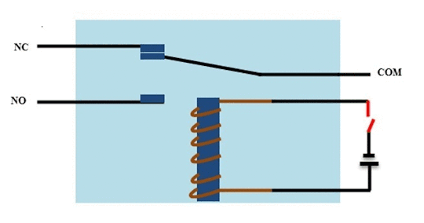
Figure: Working of Relay

Slide 18
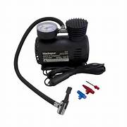
4. Compressor
Specification
Air pressure: 12V.
Cylinder diameter: 30mm.
Air compressor work by forcing atmospheric air under pressure to create potential energy that can be stored in a tank for later use.
Just like an open balloon, the pressure builds up when the compressed air is released.
Air compressor works on the principles of thermodynamics.
Figure: Compressor

Slide 19
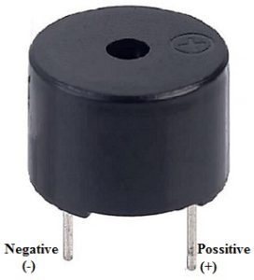
5. Buzzer
Specifications
The specifications of the buzzer include the following.
The frequency range is 3,300Hz
Operating Temperature ranges from – 20° C to +60°C
Operating voltage ranges from 3V to 5V DC
Figure: Buzzer

Slide 20
An audio signaling device like a beeper or buzzer may be electromechanical.
The main function of this is to convert the signal from audio to sound. Generally, it is powered through DC voltage and used in timers, printers, alarms, computers, etc.
Based on the various designs, it can generate different sounds like alarm, music, bell & siren.

Slide 21
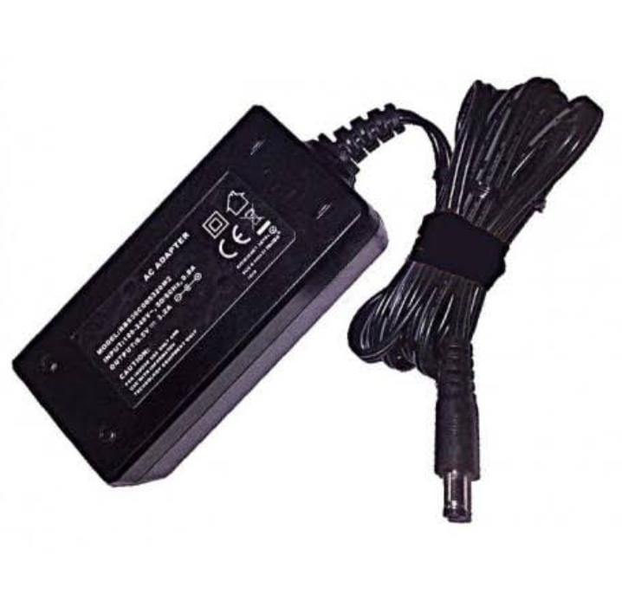
6. AC/DC Adapter
An AC/DC Adapter, also known as a power adapter or power supply.
It is a device that converts alternating current (AC) from a power outlet into direct current (DC) suitable for powering electronic devices.
AC/DC adapters are commonly used with various electronic devices such as laptops, smartphones, gaming consoles, routers, and many other consumer electronics
Figure: AC/DC Adapter

Slide 22
7. Airbag System
Airbag systems have been widely used for fall protection in various industries.
Airbag systems have proven to be an effective and reliable form of fall protection in a variety of industries.
They are often used in situations where traditional forms of fall protection, such as harnesses or safety nets, may not be feasible or effective.

Slide 23
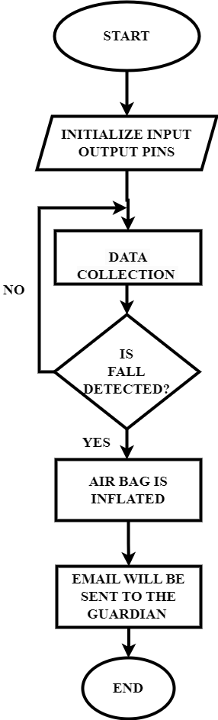
FLOW CHART

Slide 24


SOFTWARE REQUIREMENT :
1. ARDUINO IDE
Figure 1: Arduino Logo
Figure 2: Arduino IDE Window

Slide 25
The Arduino Integrated Development Environment - or Arduino Software (IDE) –
contains a text editor for writing code, a message area, a text console, a toolbar with
buttons for common functions and a series of menus.
It connects to the Arduino hardware to upload programs and communicate with them.
Install using https://www.arduino.cc/en/software
Include the packages :
https://raw.githubusercontent.com/espressif/arduino-esp32/gh-pages/package_esp32_index.json

Slide 26
RESULTS AND DISCUSSION
Airbag systems for fall protection have shown promising results in preventing injuries in various industries where falls from heights are a significant risk.
These airbag systems work by deploying a cushioned airbag at the moment of impact, reducing the force of the fall and absorbing the energy of the fall .
Airbag systems are more comfortable to wear, do not restrict movement.

Slide 27

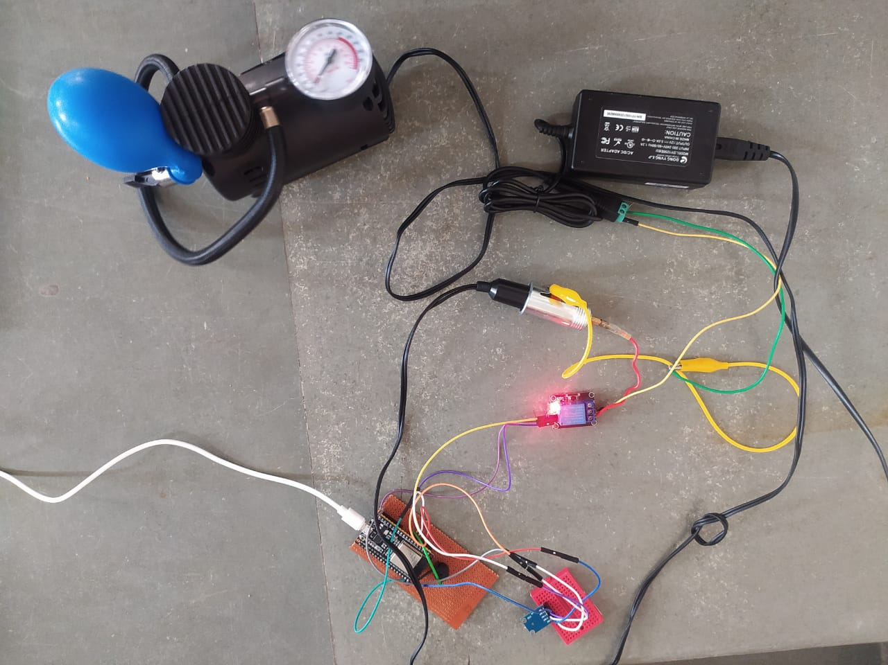
Figure 1: Fall detected
Figure 2: Setup

Slide 28

Figure: Mail sent to guardian if fall detected

Slide 29
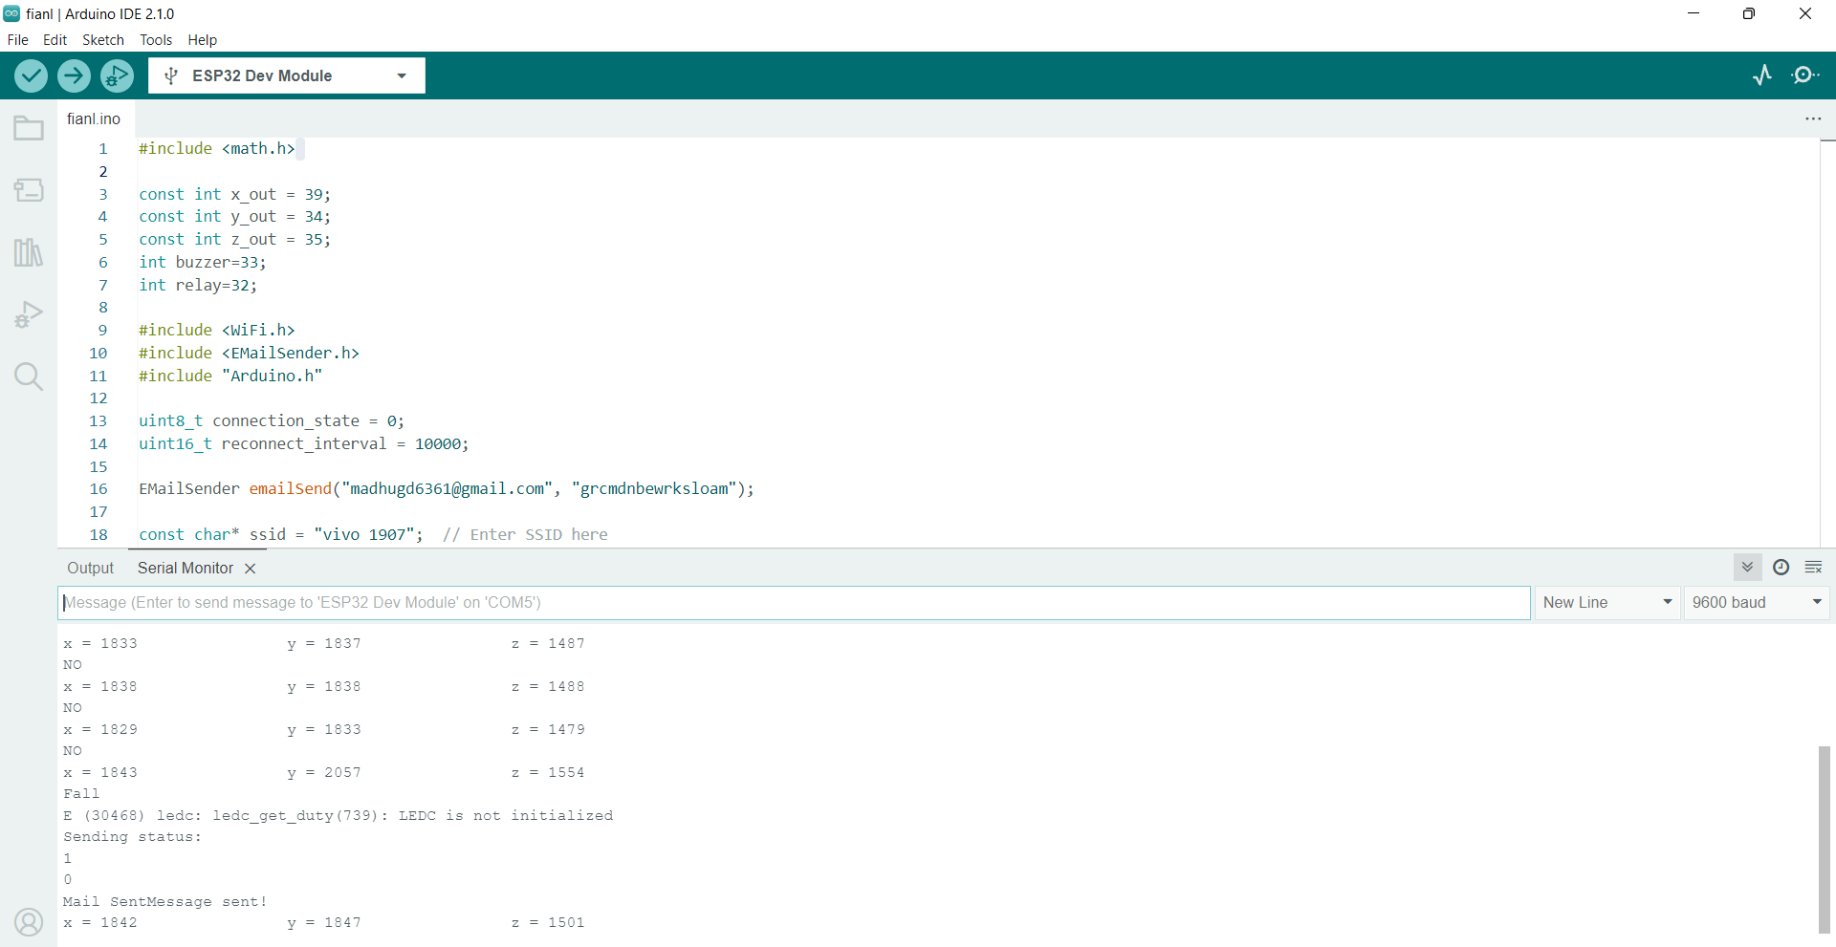
Figure: Output values of serial monitor

Slide 30
CONCLUSION
The smart airbag system for fall protection is a promising technology that has the potential to prevent severe injuries in the event of a fall.
This system uses advanced sensors and algorithms to detect falls and deploy airbags within milliseconds.
This system can be integrated into various wearable devices such as helmets, backpacks, and belts, making it versatile and easy to use in different settings.

Slide 31
FUTURE SCOPE
Location detection :Here we can improve smart air bag system by implementing location detection, it means we can detection the location of the person who fell.
Mail for multiple guardians: Here we can implement smart air bag system by implementing like we can make message or alarm will reach to the multiple guardians at a time.
Call for emergency: Here we can implement smart air bag system like After the person fell the emergency call or information will reach to the ambulance or nearest hospitals.

Slide 32
ADVANTAGES
A smart airbag system for fall protection can have several advantages over traditional fall protection systems, including:
Reduced impact force: Smart airbags can reduce the impact force of a fall by absorbing and dissipating the energy of the fall, which can help prevent injuries.
Lightweight and portable: Smart airbag systems can be designed to be lightweight and portable, making them easy to transport and install in a variety of settings.
Customizable: Smart airbag systems can be customized to fit the specific needs of different environments and users. For example, airbag size and inflation can be adjusted based on the user's weight and height.

Slide 33
Fast response time: Smart airbag systems can respond quickly to a fall, inflating within milliseconds to provide protection.
User-friendly: Smart airbag systems are typically easy to use, with simple activation mechanisms that do not require extensive training.
Low maintenance: Smart airbag systems require minimal maintenance, reducing the time and cost associated with upkeep.
Overall, a smart airbag system for fall protection can offer improved safety and convenience compared to traditional fall protection systems.

Slide 34
APPLICATIONS
Airbag systems have been also used for vehicle protection.
The application of airbag systems for fall protection can be seen in activities such as high-altitude construction work.
The application of airbag systems can also be used in entertainment industries like in stunts and etc.

Slide 35
REFERENCES
[1] “Smart Fall Detection and Protection for Elderly People” (T. Padma*1, Ch. Usha Kumari, M. Bhargav3 2020)
[2] “Arduino based human air bag system for theelderly”- Hita Prem, Ashika NA, Shilpa N, MV College of Engineering-International Journal of Current Engineering and Research (IJCER)- VOL-5, ISSUE-5,2018.
[3]“A Privacy Protected Fall Detection IoT System for Elderly Persons Using Depth Camera”- Xiangbo Kong, Zelin Meng, Lin Meng and Hiroyuki Tomiyama- Proceedings of the 2018 International Conference on Advanced Mechatronic Systems, Zhengzhou, China, Aug. 30-Sep. 2, 2018
[4] Bo Wang, Xie Ni, Guoru Zhao, Yingnan Ma, XingGao, Huiqi Li, Cuiju Xiong, Lei Wang, Shengyun Liang, “A wearable action recognition system based on acceleration and attitude angles using real-time detection algorithm”, Engineering in Medicine andBiology Society (EMBC) 2017 39th Annual International Conference of the IEEE, pp. 2385-2389, 2017
[5] “Smart Unit Care for Pre-Fall Detection and Prevention”- Ashok Kumar Thella, Vinay Kumar Suryadevara, Maher Rizkalla, and Gahangir Hossain-2016 IEEE National Aerospace and Electronics Conference (NAECON) and Ohio Innovation Summit (OIS)

Slide 36
THANK YOU

